Slide 1

Ready, Set, Revise!
Helping your child succeed at GCSE

Slide 2


Ready, Set, Revise! Helping your child succeed at GCSE
Getting the most out of Year 11.
GCSE's – General Certificate of Secondary Education
The key to unlock all next steps
A strong GCSE grade profile (5 x grade 5's or better including English and mathematics)
Experienced staff who have supported hundreds of children will provide excellent support.

Slide 3



Slide 4
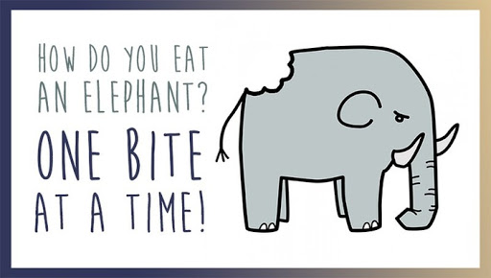
Ready, Set, Revise! Helping your child succeed at GCSE

Slide 5
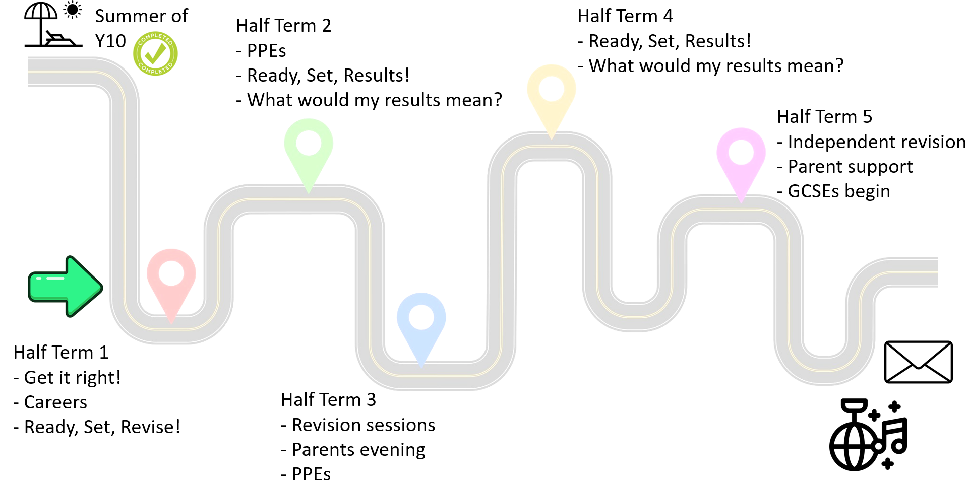
Ready, Set, Revise! Helping your child succeed at GCSE
Year 11 Roadmap
Mrs Williams – Careers Advisor (75 and 72)
Banbury College
Northampton Town FC College

Slide 6
Ready, Set, Revise! Helping your child succeed at GCSE
Key Dates
Monday 2nd November - PPE Round 1
Friday 4th December – PPE Results and future pathways
Thursday 28th January – Year 11 Parents Evening
Monday 18th January – KS5 Chenderit Interviews begin
Monday 8th February – PPE Round 2 (fewer subjects)
Friday 12th March – PPE Results and future pathways
Monday 10th May – GCSE Exams Begin
Friday 11th June – Final day of Year 11, Study leave begins
Thursday 24th June GCSE Exams finished, Year 11 Prom
Thursday 19th August – GCSE Results day

Slide 7
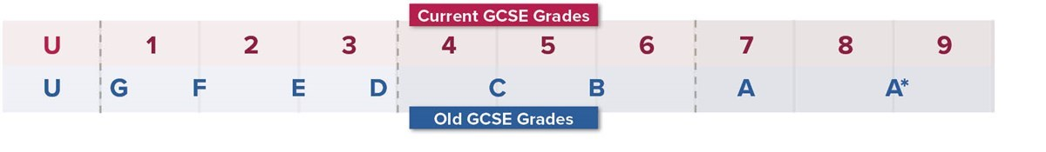
Ready, Set, Revise! Helping your child succeed at GCSE

Slide 8
Ready, Set, Revise! Helping your child succeed at GCSE
Revision – where to begin?
Scheduling certain subjects, on certain days (fun job for the weekend!)
Allocating a 1-to-2-hour block for that subject (subject dependent)
A combination of knowledge and practise
Choosing between knowledge and practise and making this part of a revision plan
Students have spent time developing knowledge resources – starting point (mind maps, flow charts and flash cards)
Time spent practising - doing, assessing and reflecting on real exam questions
Communication with teachers

Slide 9
Ready, Set, Revise! Helping your child succeed at GCSE
Revision Loop
1.5 hour revision block
30 minutes in each zone
Doesn’t need to be a whole paper
Remove distractions (phone)
Set a timer
Ensure correct exam board and specification
Struggle time
Exam Paper Questions
Assessing
Reflecting
Knowledge
Skills
Application
Refer back to knowledge resources (rev guides, flash cards, flow charts etc)
Look at model answers
Memorise (white board)
Websites with quizzing elements
Use modelled answers and solutions whilst trying similar questions
Mark using official mark scheme
Use model solutions if possible
Make a list of smaller topics/skills
What’s a silly mistake?
What’s a priority?
Use of AI

Slide 10
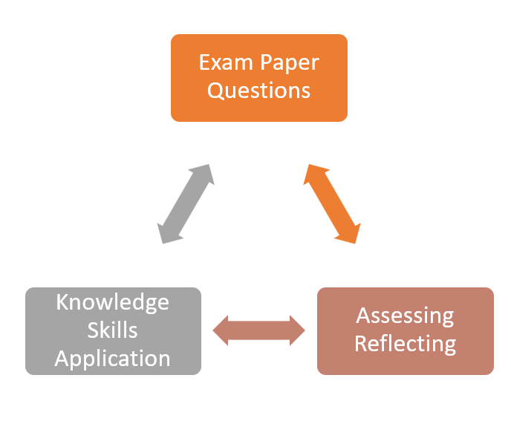
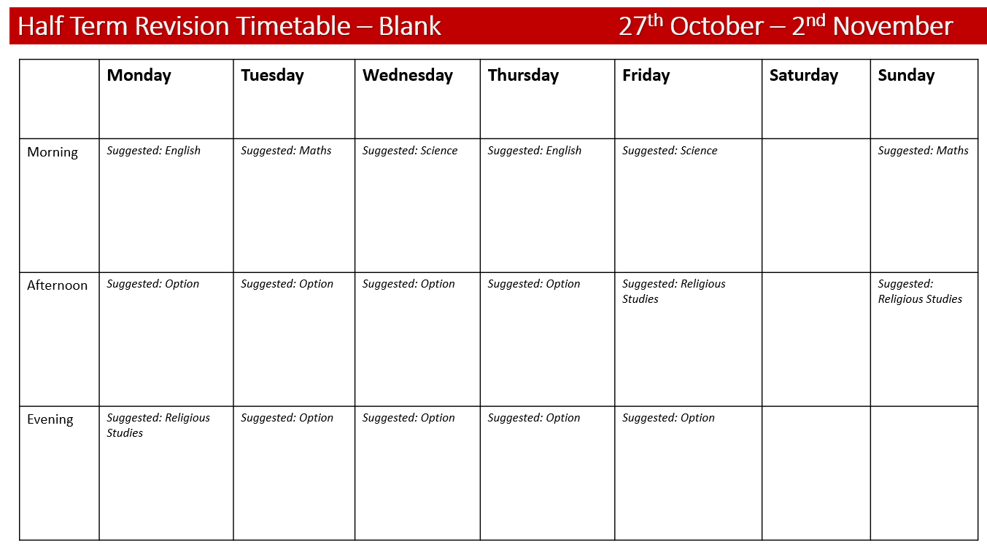
Ready, Set, Revise! Helping your child succeed at GCSE
What a revision timetable might look like…
Romeo and Juliet
Students have spent time in tutor devising a revision timetable so this can be shared with you! ☺
Geography Paper 2 – UK Geography
Christianity – 12 marker

Slide 11
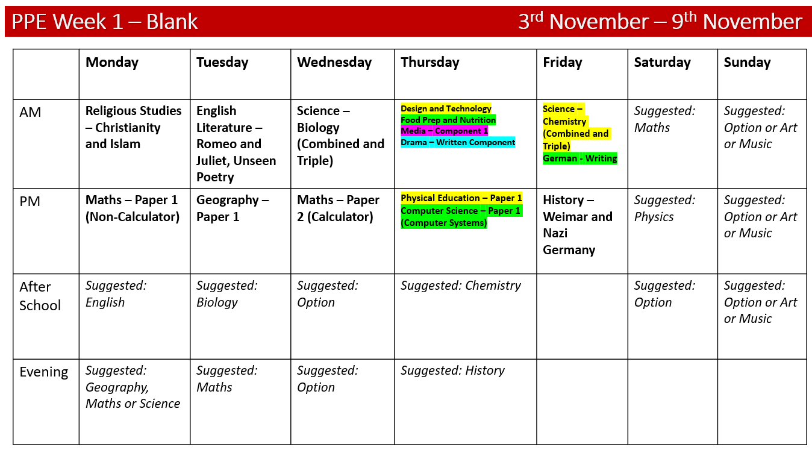
Ready, Set, Revise! Helping your child succeed at GCSE
What a revision timetable might look like…

Slide 12
English

Slide 13
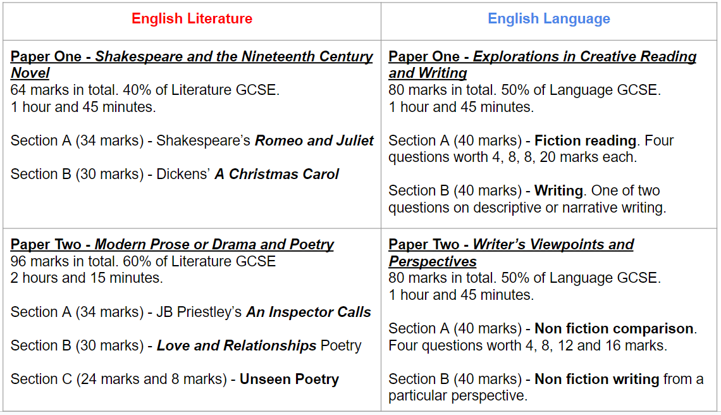

English GCSEs are two entirely independent exams.
Whilst skills are close to identical, Literature and Language offers two fantastic opportunities to attain excellent grades in really highly regarded, skill based subjects, that employers value.

Slide 14
Top Tips for English Success
Rereading set texts
Complete homework tasks
Independent revision
GCSE Pod, GCSE Bitesize
Youtube teachers: Stacey Reay, Mr Salles, Mr Bruff
Complete past paper questions, self assess with mark schemes and then hand in for teacher feedback
Read for pleasure

Slide 15
Top Tips for English Success
Read a range of texts (fiction, non-fiction, novels poetry, newspapers, magazines, blogs, online articles, apps)
Glossary of key terms
Learn key quotations
Complete activities from the revision guides and workbooks
Create posters/mindmaps/flash cards/PowerPoints on themes, characters, context, settings and plot for each text
Make new notes and highlight key points (don’t just reread old notes)

Slide 16

Top Tips for English Success
Try to teach someone else about an aspect of a text using a PowerPoint or information poster (this will help your own understanding)
Stick your newly created notes/mindmaps/posters somewhere you will see them regularly
Work in pairs or small groups to test each other’s knowledge and peer assess each other’s work

Slide 17


RAG rate course content

Slide 18



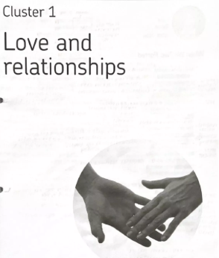
Books studied

Slide 19



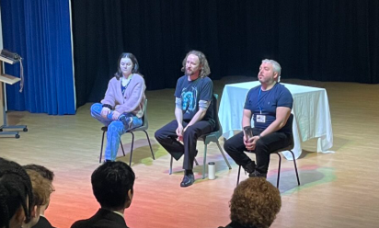
FILM, TV PRODUCTIONS and Live theatre
The Mill Arts Centre
Katch 22 ‘An Inspector Calls
March 2027- at school

Slide 20



Film, TV productions and Live Theatre
22nd January 2026
School trip
100 Y11 students
Hear from poets and chief examiner!

Slide 21
Helping your child succeed at GCSE Maths
Equivalent to 2 GCSEs

Slide 22
Ready, Set, Revise! Helping your child succeed at GCSE Maths
How to prepare for Maths
Exam Board: Edexcel
Structure: 3 Terminal Papers
1.5 Hours
All in the morning
Any content can appear on any paper

Slide 23
Ready, Set, Revise! Helping your child succeed at GCSE Maths
How to prepare for Maths
Here’s how to make revision count:
Do the Maths
(mind maps, flow charts etc. are not as effective in maths)
Little and Often
(Add 20 minute maths chunks to revision timetable)
Focus on areas to improve
(former PPEs)
Notes:
The single most important thing to understand about revising maths is that it is an active process, not a passive one. You can't revise for a maths exam by simply reading a textbook, just like you can't learn to swim by watching a video. You have to get in the water.
Here’s how to make revision count:
1.Do the Maths: Revision must involve answering questions. The best source for this is past exam papers. These are freely available on the Edexcel website. Working through these papers does two things: it builds fluency with the topics and it exposes any areas of weakness.
2.Little and Often: Cramming doesn't work for maths. The concepts need time to embed. We recommend a "little and often" approach—perhaps 25-30 minutes of focused practice, 4 or 5 times a week, is far more effective than a single, multi-hour session on a Sunday.
3.Focus on Weaknesses: After completing a past paper, your child should mark it using the official mark scheme. A great technique is the traffic light system:
1.🟢 Green: Topics they are confident with.
2.🟡 Amber: Topics where they made a silly mistake or were a bit unsure. These are high-priority for review.
3.🔴 Red: Topics they had no idea how to approach. These require going back to basics, using resources like HegartyMaths, their textbook, or coming to see their teacher for help.
Revision time should be spent turning red and amber topics into green ones.

Slide 24
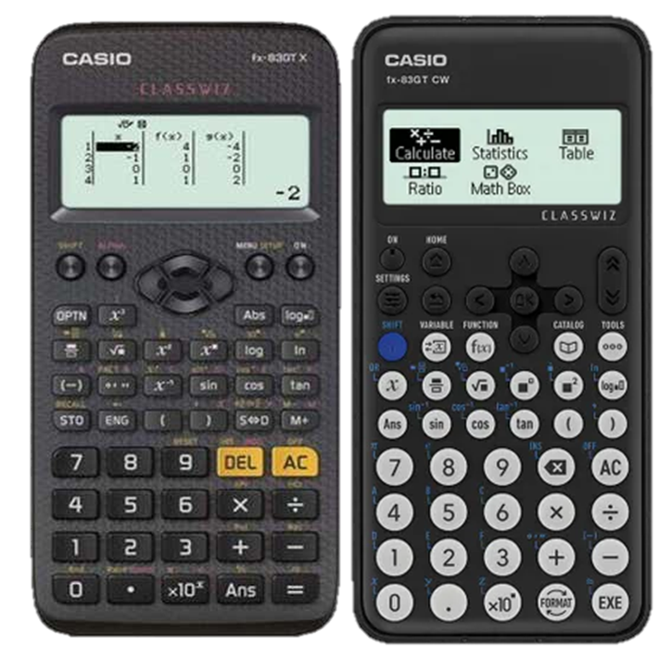
Ready, Set, Revise! Helping your child succeed at GCSE Maths
Using the Calculator as a Tool
Get the Right Tool:
Casio FX-83GTX or FX-83GTCW
There are many support videos on YouTube such as: Equaser
Notes:
Two-thirds of the final GCSE Maths grade comes from the two calculator papers. The calculator is a vital piece of equipment, and students must be experts in using their specific model.
1.Get the Right Tool: Your child should be practising with the exact same calculator they will use in the exam. The school recommends the Casio ClassWiz fx-83GTCW, as its features are specifically designed to help with the GCSE syllabus.

Slide 25
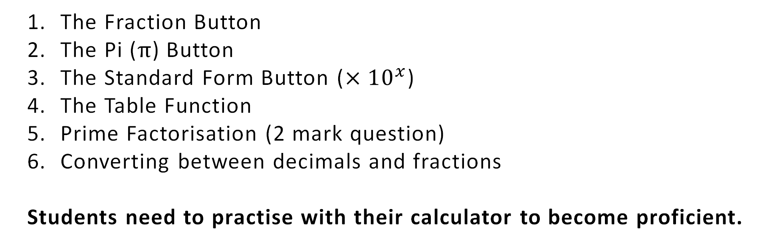
Ready, Set, Revise! Helping your child succeed at GCSE Maths
It's not just for calculations:
The Fraction Button
The Pi ($π$) Button
The Standard Form Button ($×{10}^{x}$)
The Table Function
Prime Factorisation (2 mark question)
Converting between decimals and fractions
Students need to practise with their calculator to become proficient.
Notes:
1.It's Not Just for Sums: This is not a simple four-function calculator. You can support them by simply asking if they know how to use these essential buttons:
1.The Fraction Button: It allows them to input calculations exactly as they see them written, reducing errors. They should also know how to use the S⇔D button to switch between fraction and decimal answers.
2.The Pi (π) Button: They should never type 3.14. Using the π button is more accurate and is often required to get full marks.
3.The Standard Form Button (×10x): Crucial for questions on science and astronomy, this button saves time and prevents input errors.
4.The Table Function: Incredibly useful for quickly generating coordinates to plot graphs.
Just like you’d want a musician to know their instrument, we want your child to know their calculator inside-out. It saves time, improves accuracy, and ultimately, boosts their confidence

Slide 26
Ready, Set, Revise! Helping your child succeed at GCSE Maths
In summary
Encourage Active Revision – doing questions, marking them
Use Past Papers
Master the Calculators
Notes:
1.It's Not Just for Sums: This is not a simple four-function calculator. You can support them by simply asking if they know how to use these essential buttons:
1.The Fraction Button: It allows them to input calculations exactly as they see them written, reducing errors. They should also know how to use the S⇔D button to switch between fraction and decimal answers.
2.The Pi (π) Button: They should never type 3.14. Using the π button is more accurate and is often required to get full marks.
3.The Standard Form Button (×10x): Crucial for questions on science and astronomy, this button saves time and prevents input errors.
4.The Table Function: Incredibly useful for quickly generating coordinates to plot graphs.
Just like you’d want a musician to know their instrument, we want your child to know their calculator inside-out. It saves time, improves accuracy, and ultimately, boosts their confidence

Slide 27
Helping your child succeed at GCSE Science
2 GCSEs

Slide 28
Course outline- Edexcel Science
Combined Science - worth 2 GCSE’s
Students study a broad range of all 3 Sciences
100% exam – 33.3% Biology, 33.3% Chemistry and 33.3% Physics.
There are 6 Exams – 2 for Biology, 2 for Chemistry and 2 for Physics. Each exam paper is 60 marks and 70 minutes in length.

Slide 29

Science-Combined
Students sit either a Foundation or Higher tier paper
The Foundation Tier gives access to grades from 1-1 up to 5-5
The Higher paper covers a range of grades from 4-3, all the way up to 9-9

Slide 30
Science-combined
The Grades are allocated based on the combined score for each of the 6 papers. (360 marks)
This combined score is used to rank students, with a certain % gaining each grade. For example last year 8.8% of students in the UK achieved a grade of 7-7 or above.
67% achieved a grade 4-3 or above.

Slide 31
Separate sciences – 3 GCSE’s
Content for Separate Sciences is the same as Combined Science but with some additional content.
There are two exams for each Science
Each exam is also longer, lasting 105 minutes and having 100 marks (200 in total)

Slide 32
Separate sciences – 3 GCSE’s
Students again have the option to take either Foundation or Higher Tier.
Foundation students can achieve grades 1-5, Higher tier students grades 4-9.
% grade outcomes are similar to Combined Science.

Slide 33
Parental support and homework
We value the support of parents in preparing their children for the examinations by
Helping students to be equipped for lessons (including having a scientific calculator)
Checking that homework is completed on time and to a good standard
Working with your children to support their revision especially encouraging them to put aside quality time to revise.

Slide 34

Start early
How can you learn twelve weeks work in two weeks?
Contrary to popular belief, revision doesn’t start just before exams – that’s when people can panic!
Learn by thinking about, using and remembering what we learned over a whole course……
Start early – it’s a marathon not a sprint!
Effective PPE preparation is a key ingredient overall.

Slide 35
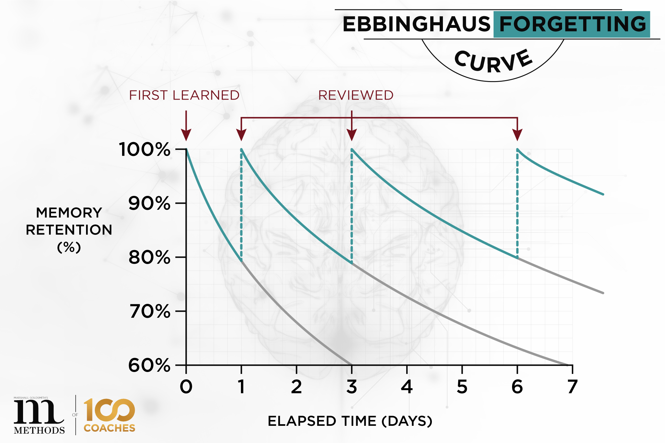
So what works well? Interrupting the forgetting curve
Revision guide – GGP are a must
Mind maps and reduction notes (dual coding)
Retrieval practice – white boards
Flash cards for key ideas and definitions
Spaced practice – it’s a marathon not a sprint
For more information follow the link below to videos that explain how to use these revision techniques https://www.learningscientists.org/videos

Slide 36
Useful Websites and Resources
Exam board including specification
https://qualifications.pearson.com/en/qualifications/edexcel-gcses/sciences-2016.html
Useful revision websites
https://cognitoedu.org/course/b2-gcse-edexcel-h-t Cognito an excellent website with animations and quizzes
https://senecalearning.com/en-GB/ SENECA, used widely by the department content and quizzes
GCSE POD – short videos with interactive content – accessible via the school website
https://www.physicsandmathstutor.com/biology-revision/gcse-edexcel/ Physics and Maths Tutor – a good website for revision notes and past paper exam questions by topic, past papers and mark schemes

Slide 37
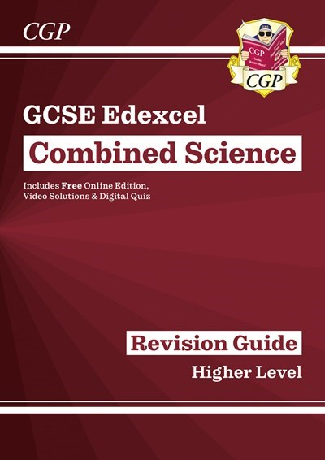
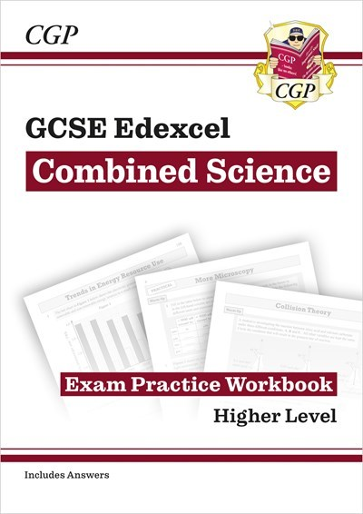
For revision notes, We recommend CGP Books

Slide 38
Ready, Set, Revise!
Helping your child succeed at GCSE
November PPE Subject Booklet

Slide 39
PPE Exam List
WEEK ONE
WEEK TWO/THREE
Date | Start | Length | Title
Mon 02 Nov | 09:00 | 01:45 | GCSE English Lang
Mon 02 Nov | 13:00 | 01:30 | Maths Paper 1 - Foundation
Mon 02 Nov | 13:00 | 01:30 | Maths Higher - Paper 1
Tue 03 Nov | 09:00 | 01:45 | RS -Religion and Ethics
Tue 03 Nov | 13:00 | 01:10 | Comb Sc Biology - Foundation
Tue 03 Nov | 13:00 | 01:10 | Comb Sc Biology - Higher
Tue 03 Nov | 13:00 | 01:45 | Triple Biology - Higher
Tue 03 Nov | 13:00 | 01:45 | Triple Biology Foundation
Wed 04 Nov | 09:00 | 01:45 | English Literature Modern text & Poetry
Wed 04 Nov | 13:00 | 01:45 | Geography Paper 1
Thu 05 Nov | 09:00 | 01:30 | Maths Higher - Paper 2
Thu 05 Nov | 09:00 | 01:30 | Maths Paper 2 (F)
Thu 05 Nov | 13:00 | 01:10 | Comb Sc Chemistry - Foundation
Thu 05 Nov | 13:00 | 01:10 | Comb Sc Chemistry - Higher
Thu 05 Nov | 13:00 | 01:45 | Triple Chemistry - Higher
Thu 05 Nov | 13:00 | 01:45 | Foundation Chemistry Triple PPE
Fri 06 Nov | 09:00 | 02:00 | Design and Technology
Fri 06 Nov | 09:00 | 01:30 | Food Preparation and Nutrition
Fri 06 Nov | 09:00 | 01:30 | Media - Component 1
Fri 06 Nov | 09:00 | 01:30 | Drama (Written Exam)
Fri 06 Nov | 13:00 | 01:30 | History - Weimar & Nazi Germany
Date | Start | Length | Title
Mon 09 Nov | 09:00 | 01:30 | Maths Higher - Paper 3
Mon 09 Nov | 13:00 | 01:30 | FP3 Maths Foundation Paper 3 (Calculator)
Mon 09 Nov | 13:00 | 01:30 | Physical Education (PPE) Paper 01
Mon 09 Nov | 13:00 | 01:30 | Comp Sc Computer Systems Paper1
Mon 09 Nov | 13:00 | 01:45 | Business Studies Paper 1
Tue 10 Nov | 09:00 | 01:10 | Comb Sc Physics - Foundation
Tue 10 Nov | 09:00 | 01:10 | Comb Sc Physics - Higher
Tue 10 Nov | 09:00 | 01:45 | Triple Physics - Higher
Tue 10 Nov | 09:00 | 01:45 | Triple Physics Foundation PPE
Tue 10 Nov | 12:30 | 00:45 | Geography - UK Geographical Issues
Tue 10 Nov | 14:00 | 01:10 | Foundation German Writing
Tue 10 Nov | 14:00 | 01:15 | Higher German Writing
Tue 10 Nov | 14:00 | 01:10 | Writing Foundation French
Tue 10 Nov | 14:00 | 01:15 | Writing Higher French
Wed 11 Nov | 09:00 | 01:45 | Music Unit 3 - Appraising
Wed 11 Nov | 09:00 | 06:00 | Art Practical (PPE)
Thu 12 Nov | 09:00 | 01:00 | Physical Education (PPE) Paper 02
Thu 12 Nov | 09:00 | 01:30 | Comp Sc Computer Systems Paper2
Thu 12 Nov | 13:00 | 01:15 | H&SC Principles of care
Thu 12 Nov | 13:00 | 00:35 | Foundation German Listening
Thu 12 Nov | 13:00 | 00:45 | Higher German Listening
Thu 12 Nov | 13:30 | 00:45 | Foundation German Reading
Fri 13 Nov | 09:00 | 00:35 | Listening Foundation French
Fri 13 Nov | 09:00 | 00:45 | Reading Foundation French
Fri 13 Nov | 09:00 | 00:45 | Listening Higher French
Fri 13 Nov | 09:00 | 01:00 | Reading Higher French
Fri 13 Nov | 09:00 | allday | Drama Practical
Tue 17 Nov | 09:00 | allday | Drama Practical

Slide 40
Half Term Revision Timetable – Blank 26th October – 1st November
 | Monday | Tuesday | Wednesday | Thursday | Friday | Saturday | Sunday
Morning | Suggested: English | Suggested: Maths | Suggested: Science | Suggested: English | Suggested: Science |  | Suggested: Maths
Afternoon | Suggested: Option | Suggested: Option | Suggested: Option | Suggested: Option | Suggested: Religious Studies |  | Suggested: Religious Studies
Evening | Suggested: Religious Studies | Suggested: Option | Suggested: Option | Suggested: Option | Suggested: Option

Slide 41
PPE Week 1 – Blank 2nd November – 8th November
 | Monday | Tuesday | Wednesday | Thursday | Friday | Saturday | Sunday
AM | English Language Paper One | Religious Studies | English Literature (Modern Text and Poetry) | Maths Paper Two | Design Technology Food Preparation and Nutrition Media Studies Drama | Suggested: Maths | Suggested: Option or Art or Music
PM | Maths – Paper 1 (Non-Calculator) | Science (Combined and Triple - Biology) | Geography Paper One | Combined Science Triple Science - Chemistry | History – Weimar and Nazi Germany | Suggested: Physics | Suggested: Option or Art or Music
After School | Suggested: Religious Studies | Suggested: English Literature | Suggested: Maths | Suggested: Option |  | Suggested: | Suggested:
Evening | Suggested: Science | Suggested: Geography/ Maths | Suggested: Science | Suggested: Option/History

Slide 42
PPE Week 2 – Blank 9th November – 13th November
 | Monday | Tuesday | Wednesday | Thursday | Friday | Tuesday 17 November
AM | Maths Paper 3 | Combined Science/Triple Science - Physics | Art Practical – All Day Music Unit 3 - Appraising | Physical Education Paper 2 Computer Science Paper 2 | French Listening French Reading Drama Practical – all day | Drama Practical – All day
PM | Physical Education Computer Science Paper One Business Studies Paper One | Geography – UK Geographical Issues German - Writing French - Writing | Art Practical | Health and Social Care - Principles of Care German Listening German Reading | Drama Practical
After School | Suggested: Science | Suggested: Music | Suggested: H&Soc, German | Suggested: French/Drama
Evening | Suggested: Geography/German/French | Suggested: Computer Science/PE | Suggested: PE, Computer Science

Slide 43
Subject Information
Subject Head of Department, Exam Date(s) | Key Areas to Revise November PPE | Useful Websites/ Resources | Any other information
Religious Studies Mr Bonnett mbonnett@chenderit.net Tuesday 3rd Nov– 9:00am | Christian Beliefs Living the Christian Life Muslim Beliefs Living the Muslim Life | BBC Bitesize – Edexcel RS B Save My Exams – Edexcel RS B CGP Revision Guide (book) - GCSE Edexcel Religious Studies B | Resources for revision are being delivered in lessons Kerboodle Access – see class teacher Revision guides – on Edulink
Mathematics Mr Huckin hhuckin@chenderit.net Monday 2nd Nov – 13:00 (Paper 1) Thursday 5th Nov – 09:00 (Paper 2) Monday 9th Nov – 09:00 (Paper 3) | Number Fractions, decimals, percentages Ratio Simplifying, sharing, combining Algebra Simplifying, expanding, factorising, solving equations and inequalities Geometry and Measure Perimeter, area, angle rules, Pythagoras, Trigonometry Statistics and Probability Types of chart, simple probability, relative frequency | Maths Genie Dr Frost Corbett Maths 1st Class Maths Go Teach Maths Maths and Physics Tutor https://sparxmaths.com/ | Suggested calculator is Casio FX-83GTX or FX-83GTCW

Slide 44
Ready, Set, Revise! Helping your child succeed at GCSE
Other considerations
Place to revise – consistent place Vs. change of scenery
Mini whiteboards, whiteboard pens
Revision specific exercise books
Other equipment - highlighters, calculator and any other exam equipment
Phones

Slide 45
Ready, Set, Revise! Helping your child succeed at GCSE
Resources
November PPE subject booklet – to take away
Blank revision timetables – to take away
Copy of these slides – digital

Slide 46
Ready, Set, Revise! Helping your child succeed at GCSE
The night before
Some past paper questions
Recall – draw mind map out from scratch or quizzing at dinner
Equipment ready the night before

Slide 47
Ready, Set, Revise! Helping your child succeed at GCSE
The morning of
Exam briefing from an experienced subject expert
Physical exam aid produced to support students

Slide 48
Ready, Set, Revise! Helping your child succeed at GCSE
Revision Loop
1.5 hour revision block
30 minute sprint in each zone
Real exam questions,
knowledge, skills and application
are all accessible in the subject
booklet
Exam Paper Questions
Assessing
Reflecting
Knowledge
Skills
Application

Slide 49
Ready, Set, Revise! Helping your child succeed at GCSE
Support
Mrs Dowden – Head of Year 11
Mr Billings – Headteacher
Mr Huckin, Mr Lindsay, Mrs Grant (Lecture Theatre)
Heads of Department – contacts are in the booklet
Mrs Williams – Careers Advisor (75 and 72)
The British Army - Cpl Dean Gardner
Activate Learning Banbury College - Charlotte Roan
Brick Kiln Composites - Josh Tee (Engineering apprenticeships)
Northampton College (Apprenticeship scheme) - Will Brown

